Slide 1
Powershell As A Service
Justin Grote
Datacenter Solutions Architect
Allied Digital Services LLC

Slide 2
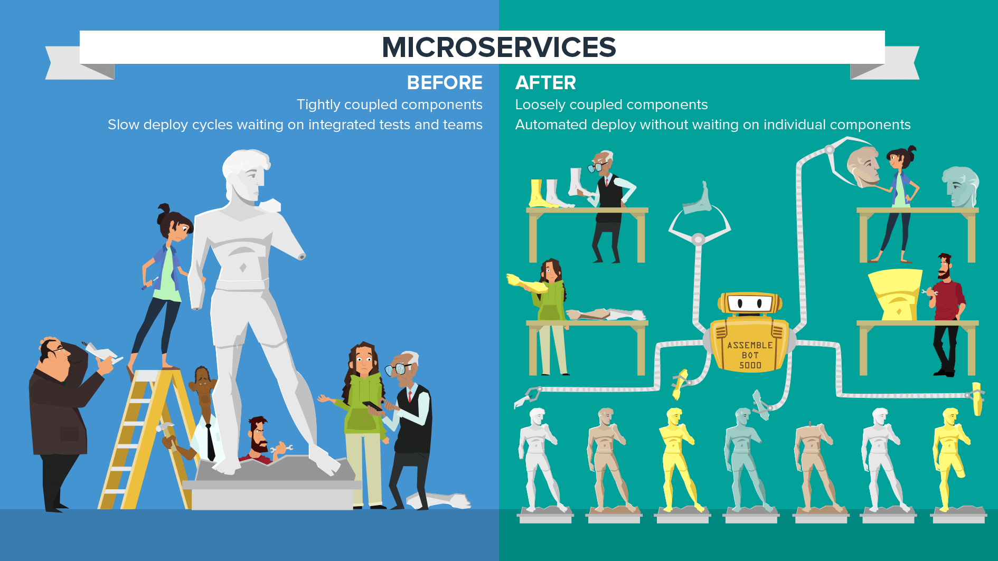

Slide 3
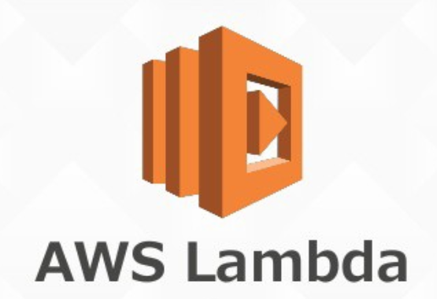

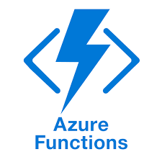

Platform | Powershell Version | OS | Best For
AWS Lambda | Powershell Core | Linux | Microservices/APIs
Azure Automation | Windows Powershell 5.0 | Windows 2012 | Beginners, Long Running Scripts
Azure Functions v1 | Windows Powershell 5.1 | Windows 2016 | Experimental
Azure Functions v2 | Powershell Core | Linux | Microservices/APIs

Slide 4




Continuous Deployment
Orchestration
Script / Template
Manual Deployment

Slide 5
Manual Deployment
https://aws.amazon.com/blogs/developer/announcing-lambda-support-for-powershell-core/
https://www.brianbunke.com/blog/2018/02/27/powershell-in-azure-functions/
https://azure.microsoft.com/en-us/resources/videos/get-started-with-azure-automation/
https://github.com/Azure/azure-functions-powershell-worker

Slide 6
Continuous Deployment
Orchestration
Script / Template
Manual Deployment

Slide 7

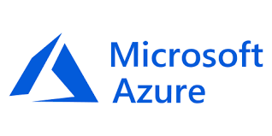
Continuous Deployment
Manual Deployment
Script / Template
AWS CLI
AWS CloudFormation
AWS Tools for Windows Powershell
Azure CLI AzureRM Templates
Az Powershell Module
Orchestration

Slide 8
Continuous Deployment
Orchestration
Script / Template
Manual Deployment

Slide 9
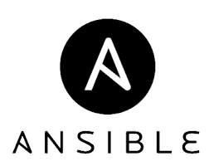
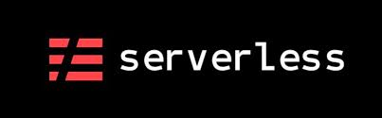





Manual Deployment
Orchestration
General Purpose
Specialist
Continuous Deployment
Script / Template

Slide 10
Continuous Deployment
Orchestration
Script / Template
Manual Deployment

Slide 11


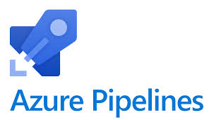


Orchestration
Manual Deployment
Continuous Deployment
Script / Template

Slide 12
Continuous Deployment
Orchestration
Script / Template
Manual Deployment

Slide 13
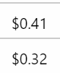
Azure Functions Costs – Ticket Integration
80 Lines of Code
11,800 Executions Per Month

